Slide 1
Databases: Setting Up
Billy Rogers

Slide 2
Basic Concepts
Entity: a “Thing”
Relationship: a “Connection between Things”
Relational Model shown as ”ER Diagram”

Slide 3
Types of Databases
Buy/Sell
Amazon
EBay
Hospital
Relational
Transactional
Analytics
Reporting
HEB
Daily Weather
Sales/Marketing
Drug Efficacy
McDonald’s
Your Dashboard
Allergies on the News
Bank Statements
Business Intelligence BI

Slide 4
Normalization: Reduce Time/Effort/Cost
Reduce DB work (time/effort)
Reduce redundancy (time/cost)
Prevent work when things change (time/effort)
Make clear to users (time/effort)

Slide 5
Normalization
Make atomic (remove lists)
Split into entities (students, pets)
Reduce redundancy
Ensure only columns relating to primary key
Ensure all tables can reach related tables

Slide 6
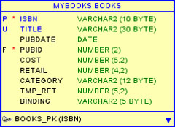
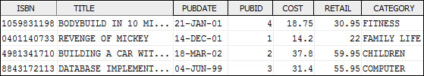
Entity BOOKS (Table)
Logical Entity
Column Names
Column Data Types
Physical Entity
Column Names
Column Data
Return

Slide 7
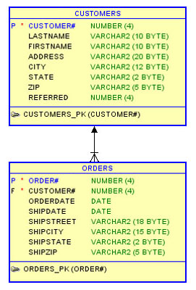
Relationship: Logical
Parent
1. One Parent may have many children
2. Each child must have at least one parent
3. If no parent
child: orphan
Child
Return

Slide 8
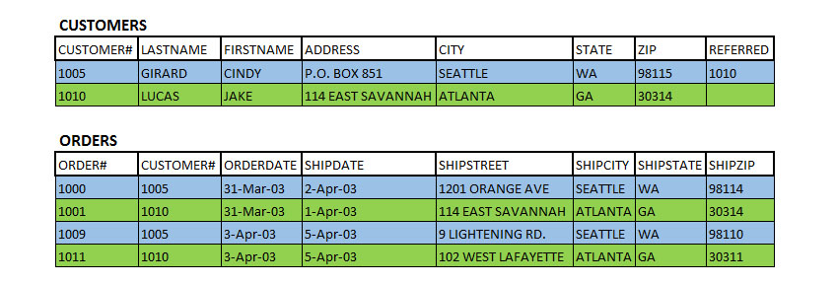


Relationship: Physical
Child

Slide 9
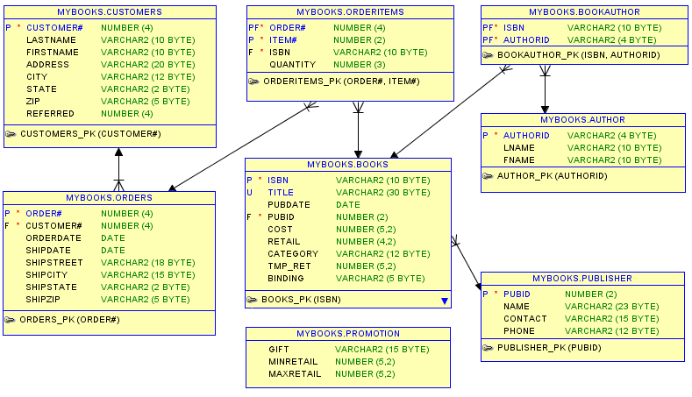
ER Diagram: Logical Entities/Relationships

